Slide 1
Nordic Dronebase

Slide 2
Why?
Drones are great for surveillance, so why not make it as autonomous as possible?
Dronebases that are on the market are not capable of working properly in nordic countries without constant maintenance

Slide 3
Idea
Dronebase for arctic environment
Fully autonomous
For everyone who needs air surveillance
Minimum maintenance
High quality parts

Slide 4
3 different approaches
Solution 1
Base for single drone
Minimal base size
Easy to deploy as a single base or a set of bases
Charges drone's built-in battery
Air conditioned, can control base temperature and humidity
Solution 2
Base for single drone, with hot-swap batteries
Minimal downtime for single drone
Hot-swap batteries for drone: fly one, recharge others
Air conditioned, can control base temperature and humidity
Solution 3
Base for multiple drones
Contains multiple drones
Minimal housing for single drone
Charges drones' built-in batteries
Air conditioned, can control base temperature and humidity

Slide 5
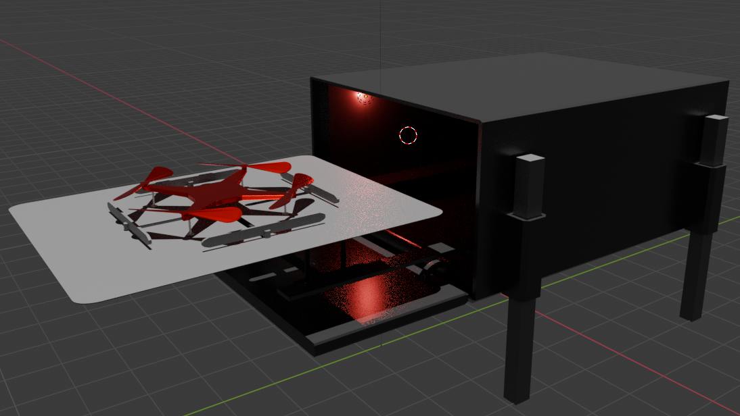
Solution 1

Slide 6
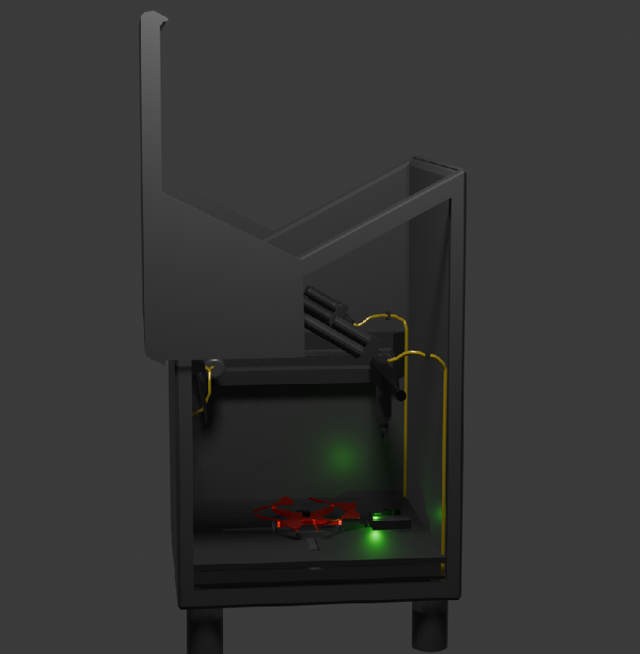
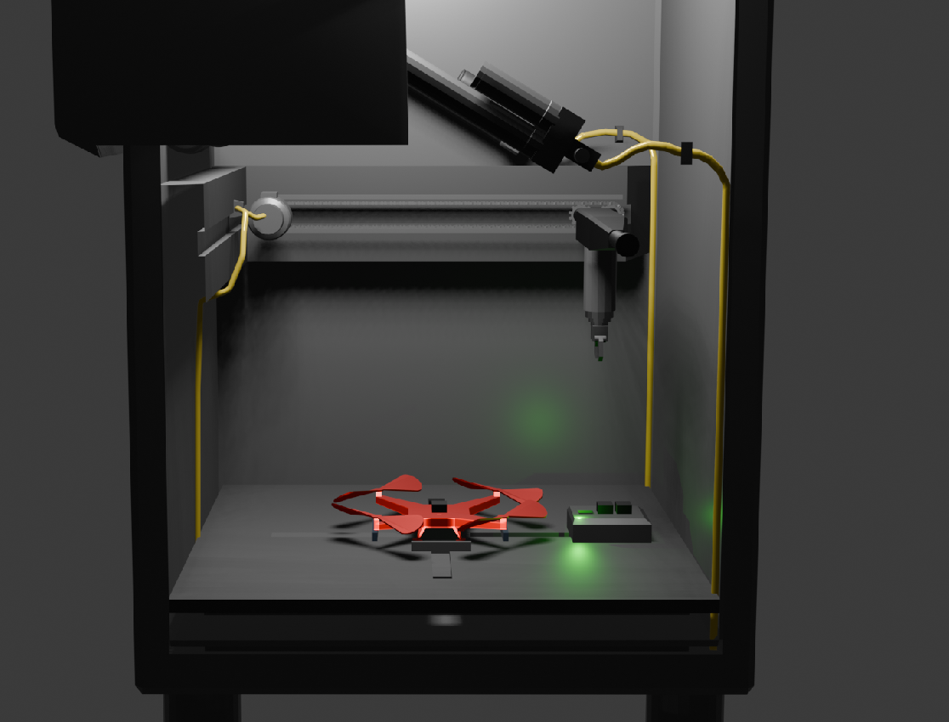
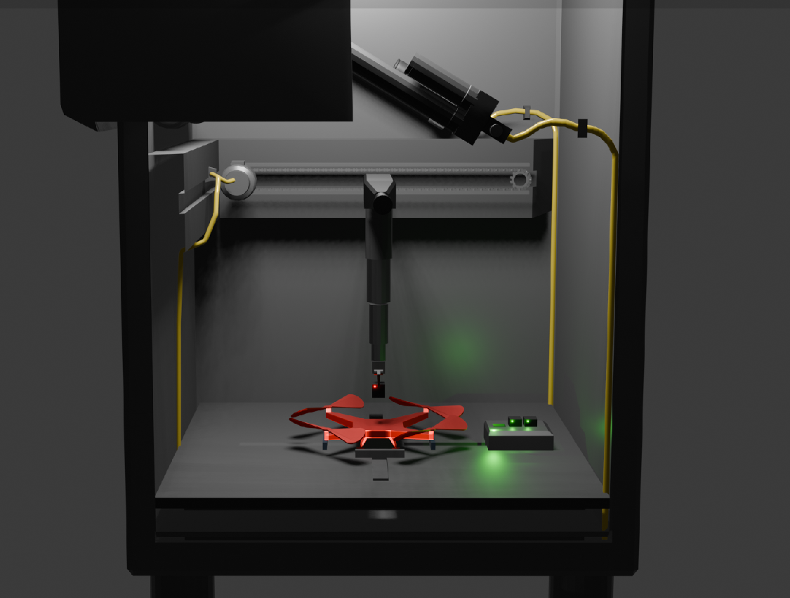
Solution 2

Slide 7
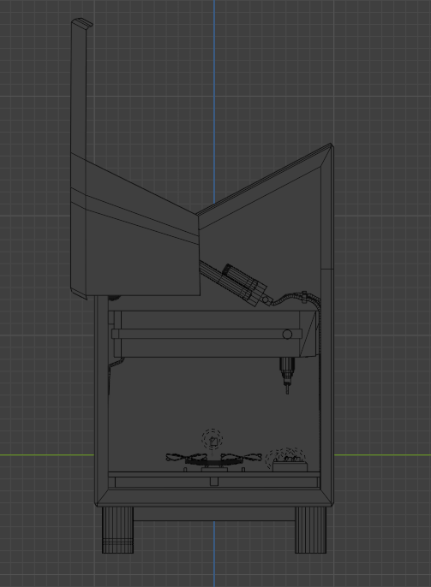
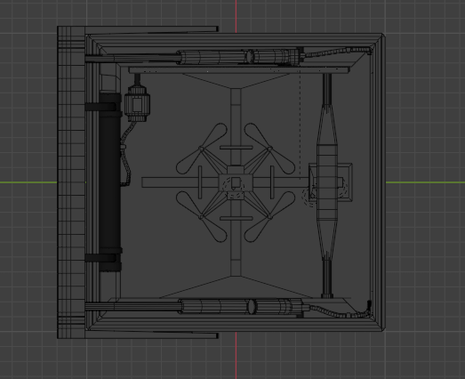

Slide 8
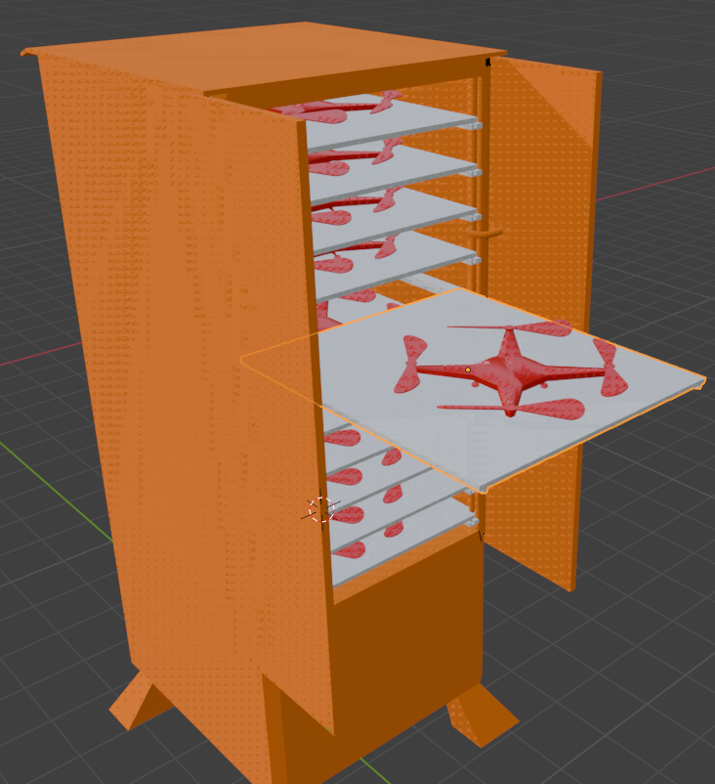
Solution 3

Slide 9
Our Team
Taneli Huikari
Ville Kovalainen
Jani Heikkilä
Johannes Päivärinta
Tuomas Jurvansuu
Antti Rytilahti

